Slide 1
Lecture Neural Nets(NN) for XOR

Slide 2
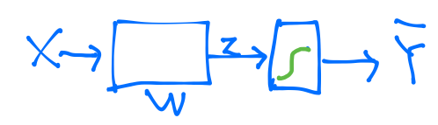
One logistic regression unit cannot separate XOR
Notes:
하나로는 풀수가 없음

Slide 3
Multiple logistic regression units
Notes:
여러 개를 붙이면 풀수가 있음

Slide 4
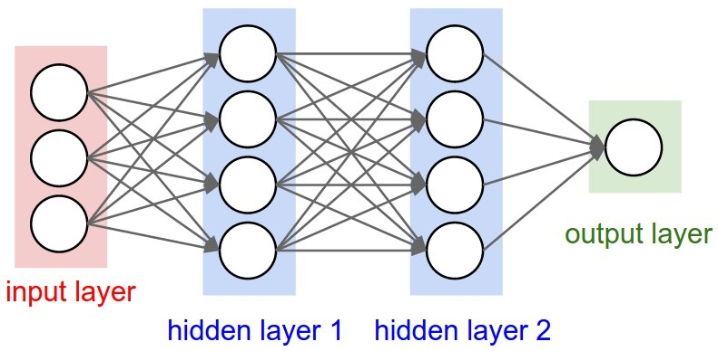
Neural Network (NN)
“No one on earth had found a viable way to train*”
*Marvin Minsky
http://cs231n.github.io/convolutional-networks/
Notes:
몇 개 더 넣어야 하는데, 나도 그 학습 방법을 모르는데, 너희도 안된다. 글을 잘 쓰신듯. 매우 설득력있었고 모두에게 받아 들여짐. AI 의 암흑기. 69-86

Slide 5
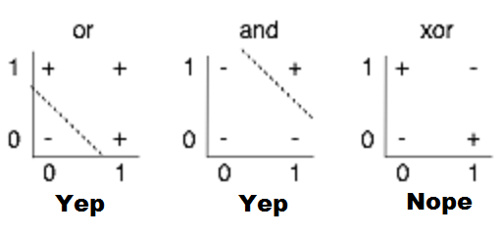
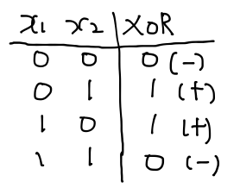
XOR using NN

Slide 6
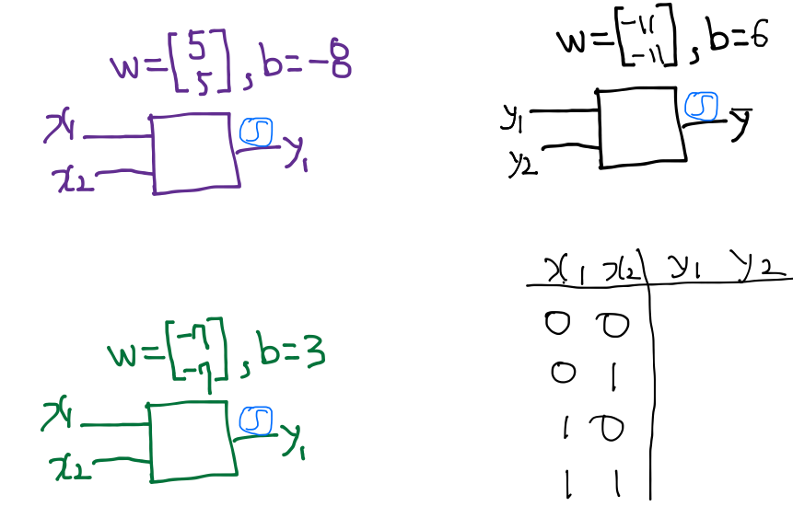
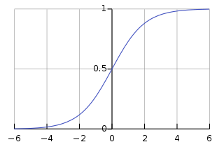
Neural Net
WX+b

Slide 7
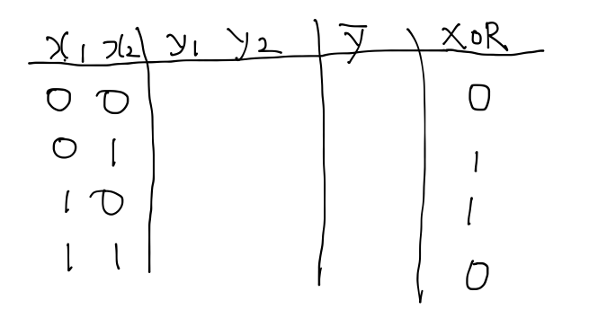
Neural Net

Slide 8
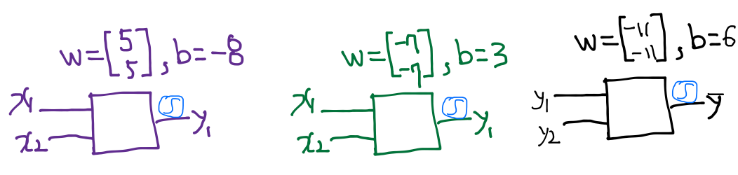
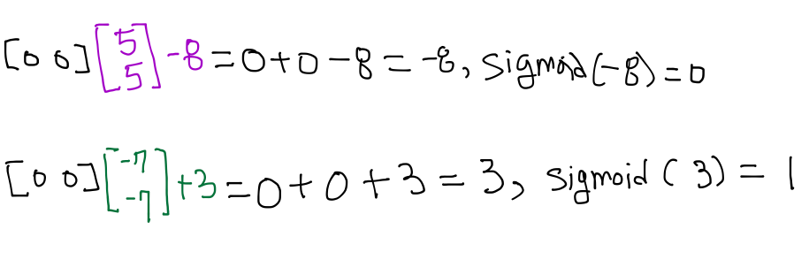
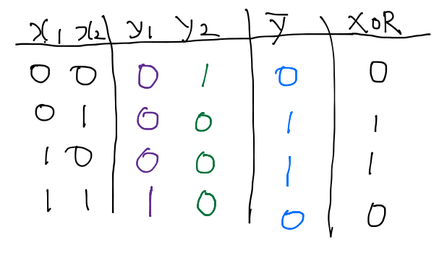
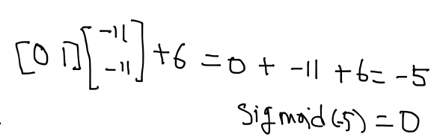

Slide 9
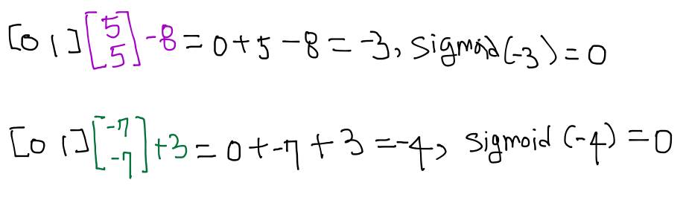
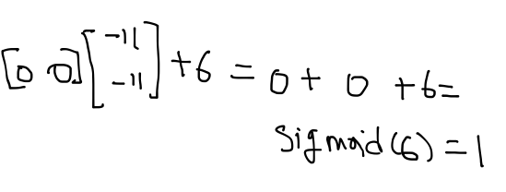

Slide 10
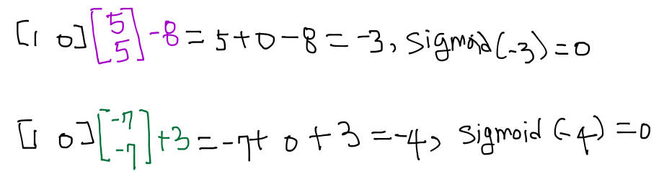
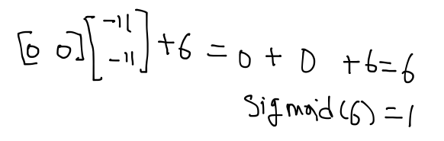

Slide 11
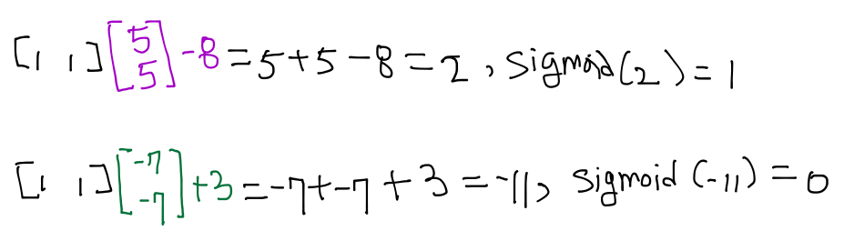
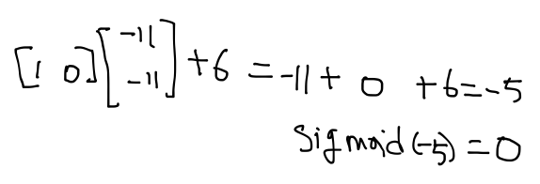

Slide 12
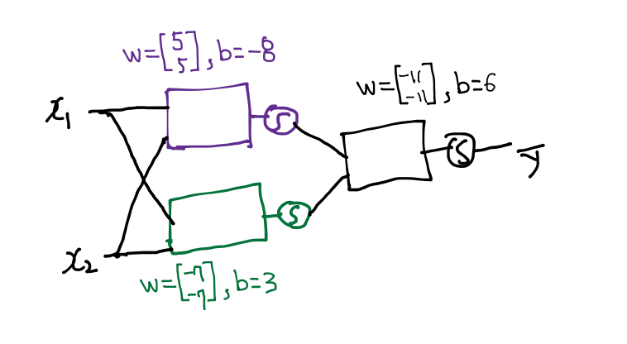
Forward propagation
Can you find another W and b for the XOR?
Notes:
이게 Neural Network

Slide 13
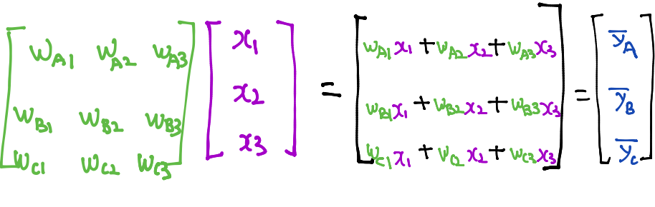
Recap: Lec 6-1 Multinomial classification

Slide 14
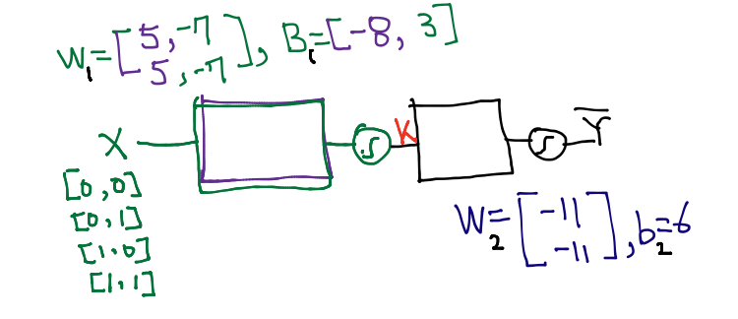

NN
How can we learn W, and b from trading data?

Slide 15
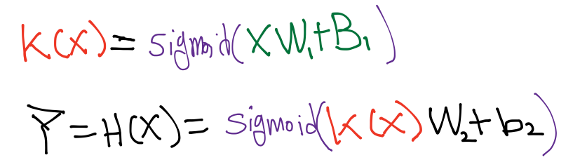

NN
How can we learn W1, W2, B1, b2 from training data?

Slide 16
How can we learn W1, W2, B1, b2 from training data?
Gradient Descent Algorithm
Notes:
Gradient decent을 이용해야 됨. 미분을 할 수 있어야 됨

Slide 17
Derivation
Notes:
각각의 노드가 Y_hat에 미치는 영향을 구할 수 있어야 됨

Slide 18
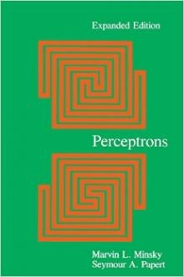
Perceptrons (1969)
by Marvin Minsky, founder of the MIT AI Lab
We need to use MLP, multilayer perceptrons (multilayer neural nets)
No one on earth had found a viable way to train MLPs good enough to learn such simple functions.
Notes:
Minsky’s book convinced most of the world that neural networks were a discredited dead-end – the worst kind of heresy.
SKynet == DeepNet, 반란군이 보낸 분일지도: Neural Network 20년 정도 발전을 늦게 함.

Slide 19
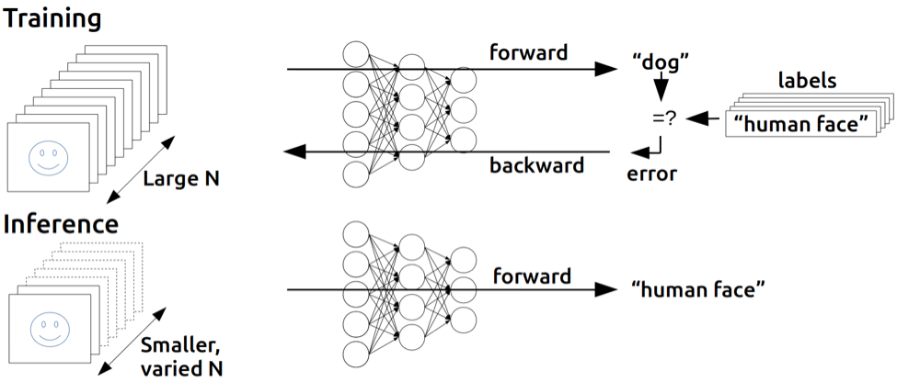
Backpropagation
(1974, 1982 by Paul Werbos, 1986 by Hinton)
Notes:
민스키의 말을 듣지 않음 사람. 귓등으로 흘린분. Hinton.

Slide 20
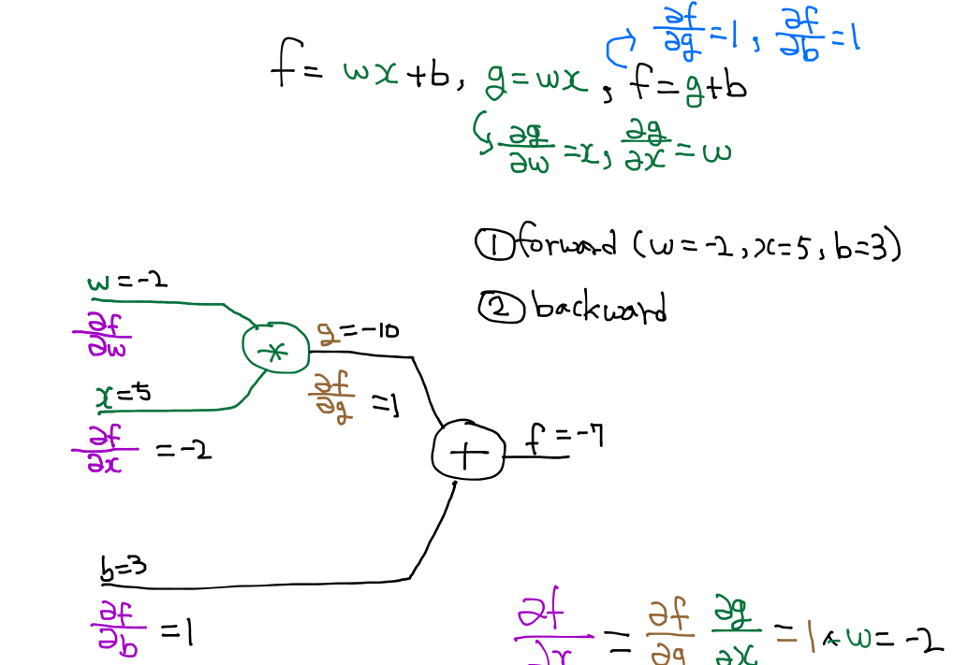
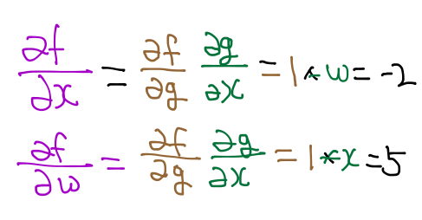
Back propagation (chain rule)

Slide 21
Back propagation (chain rule)
http://cs231n.stanford.edu/

Slide 22
Back propagation (chain rule)
http://cs231n.stanford.edu/

Slide 23
Back propagation (chain rule)
http://cs231n.stanford.edu/

Slide 24
Back propagation (chain rule)
=5
w
http://cs231n.stanford.edu/
Notes:
B가 미치는 영향은 1:1 ,
W가 미치는 영향은 w가 1바뀌면 결과가 5배 바뀐다는 뜻

Slide 25
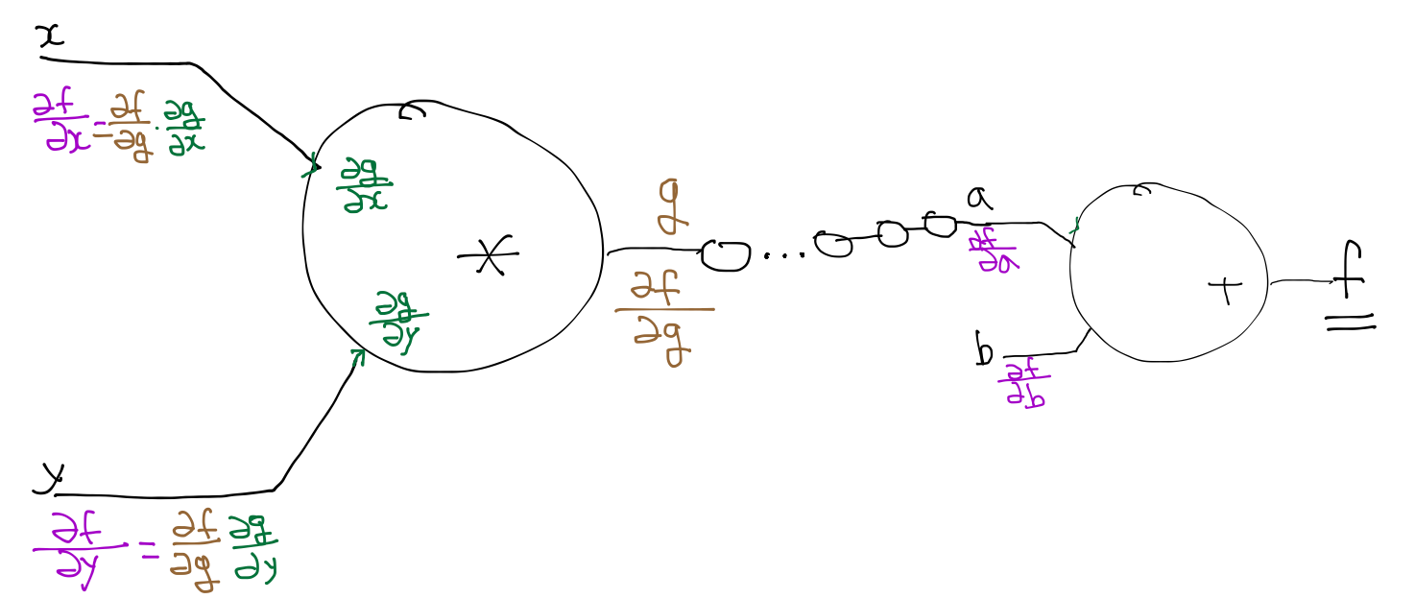
Back propagation (chain rule)
http://cs231n.stanford.edu/
Notes:
Chain rule로 맨 뒤부터 계산하면 전부 계산 할 수가 있음

Slide 26
Back propagation (chain rule)
3. 알고 있는 것 두개를 곱하면 됨
2. g = x*y 를 알기 때문에 알 수 있음
1. 알고 있음
http://cs231n.stanford.edu/

Slide 27
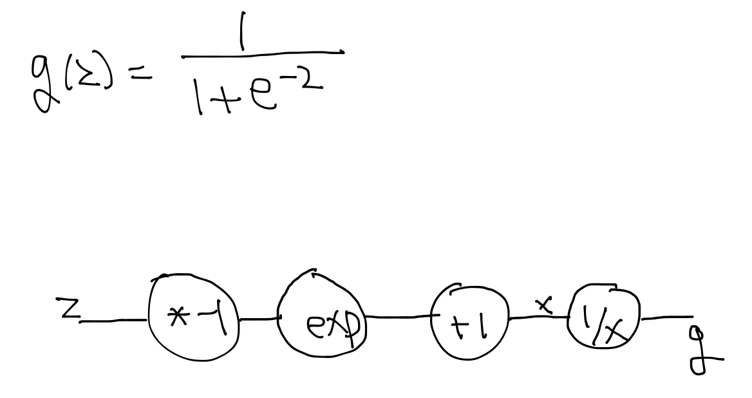
Sigmoid

Slide 28
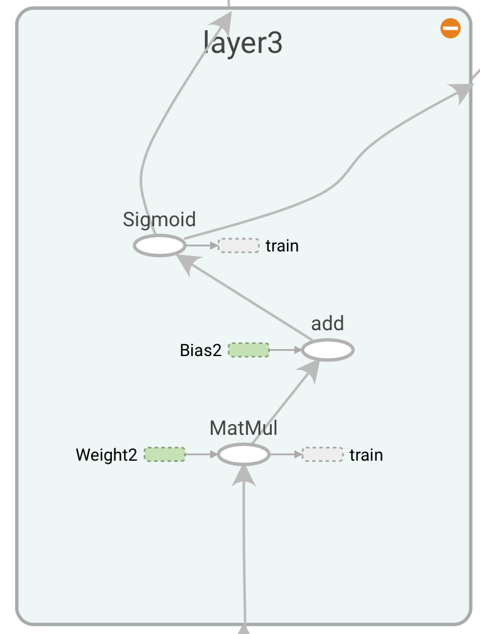
Back propagation in
TensorFlow
TensorBoard
Notes:
BP를 하기 위해서 Tensorflow에서는 그래프로 표시해놓음

Slide 29
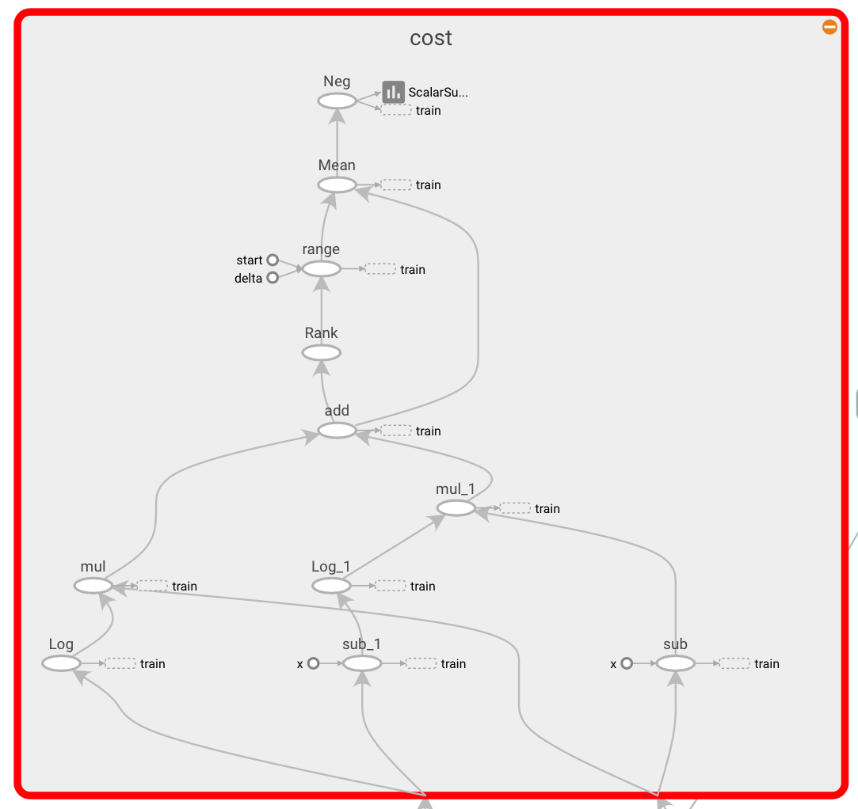
Back propagation in
TensorFlow
TensorBoard

Slide 30
Back propagation
Notes:
아무리 복잡해도 기계적으로 구할 수 있음

Slide 31
Perceptrons (1969)
by Marvin Minsky, founder of the MIT AI Lab
We need to use MLP, multilayer perceptrons (multilayer neural nets)
No one on earth had found a viable way to train MLPs good enough to learn such simple functions.
Notes:
이걸 이해했다면 민스키가 절대 풀수 없다고 한 문제를 이해한것

